Slide 1
Lesson 10 – Input and Output

Slide 2
Plan
IO, NIO/NIO2
Resource Management
Serialization
Encodings

Slide 3
Java IO basically provides a mechanism to read data from a source and write data to a destination.

Slide 4
IO Evolution
1996
2002
2011
2022
IO
NIO
NIO2

Slide 5
IO Blocking Input/Output

Slide 6
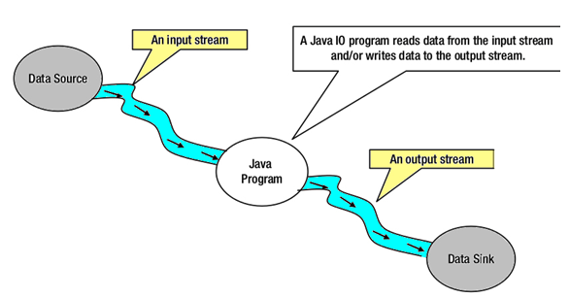
Blocking IO – java.net.*
Stream - a continuous flow of data (bytes, chars, objects)

Slide 7
Built-in streams
System.in
System.err
System.out

Slide 8
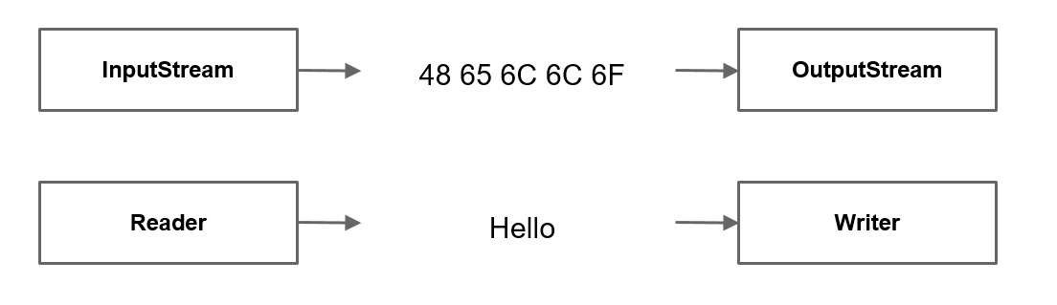
Stream types
By direction
Input
Output
By content
Bytes
Characters

Slide 9
InputStream
int read() / read(…)
void close()
boolean markSupported()
void mark(readLimit) / reset()
long skip(n)
int available()

Slide 10
OutputStream
write(byte bytes[]) / write(…)
flush()
close()

Slide 11
InputStream/OutputStream
InputStream in = new FileInputStream(source); OutputStream out = new FileOutputStream(destination) int byteRead; while((byteRead = in.read()) != -1) { out.write(byteRead); }

Slide 12
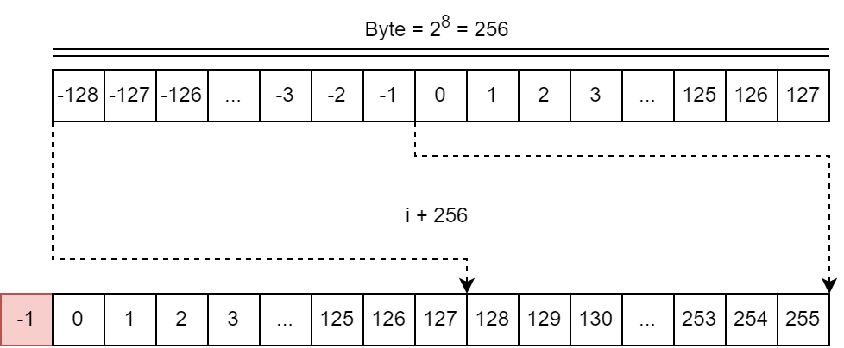
Bytes

Slide 13
Reader/Writer
Reader reader = new FileReader(source); Writer writer = new FileWriter(destination); int charRead; while ((charRead = reader.read()) > -1) { writer.write(charRead); }

Slide 14
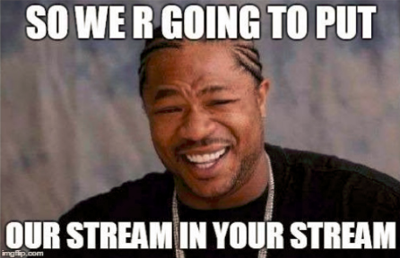
Stream types
By abstraction level
Low
High
FileInputStream fis = new FileInputStream(“file.dat"); BufferedInputStream bfis = new BufferedInputStream(fis); ObjectInputStream objectStream = new ObjectInputStream(bfis);

Slide 15
Stream types
Name | Level | Description
FileInputStream | Low | Reads file data as bytes
FileOutputStream | Low | Writes file data as bytes
FileReader | Low | Reads file data as characters
FileWriter | Low | Writes file data as characters
BufferedReader | High | Reads character data from an existing Reader in a buffered manner
BufferedWriter | High | Writes character data to an existing Writer in a buffered manner
ObjectInputStream | High | Deserializes primitive Java data types and graphs of Java objects from an existing InputStream
ObjectOutputStream | High | Serializes primitive Java data types and graphs of Java objects to an existing OutputStream
InputStreamReader | High | Reads character data from an existing InputStream
OutputStreamWriter | High | Writes character data to an existing OutputStream
PrintStream | High | Writes formatted representations of Java objects to a binary stream
PrintWriter | High | Writes formatted representations of Java objects to a text-based output stream

Slide 16
Input / Output
File – bytes java.exe, movie.mp4, …
Directory - bytes c:/Program Files/Java, /home, …
Root directory - c:/, /
Path – string representation /user/home/zoo.txt, video/fun.3gp, …

Slide 17
File
java.io.File
directories as well as files
Does not require file existence for instantiation of File class
Types:
Relative - new File(“temp/taxiPark.db");
Absolute - new File("/temp/taxiPark.db");

Slide 18
File
exists()
getName()
getParent()
getAbsolutePath()
isDirectory(), isFile()
length()
lastModified()
delete()
renameTo(File)
mkdir(), mkdirs()
listFiles()

Slide 19
File
File file = new File("/temp/taxiPark.db"); print("File Exists: " + file.exists()); if (file.exists()) { print("Absolute Path: " + file.getAbsolutePath()); print("Parent Path: " + file.getParent()); if (file.isFile()) { print("File size: " + file.length()); print("File Last Modified: " + file.lastModified()); } else { print("Traversing Directory"); for (File subfile : file.listFiles()) { print("\t" + subfile.getName()); } } }

Slide 20
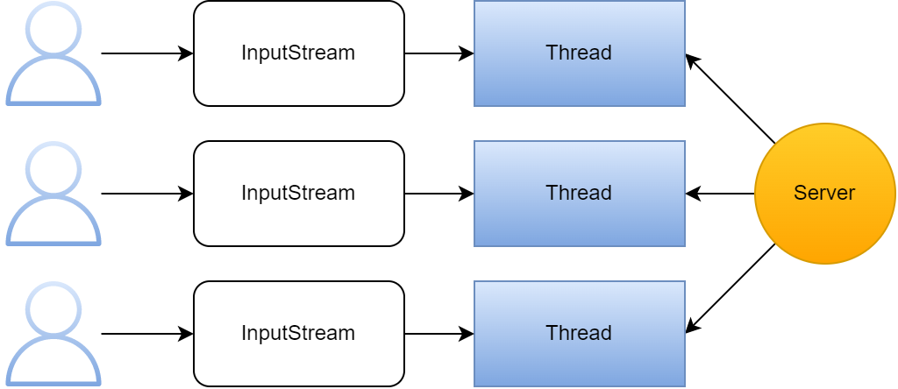
IO problem

Slide 21
NIO / NIO2 Non-Blocking (New) IO

Slide 22
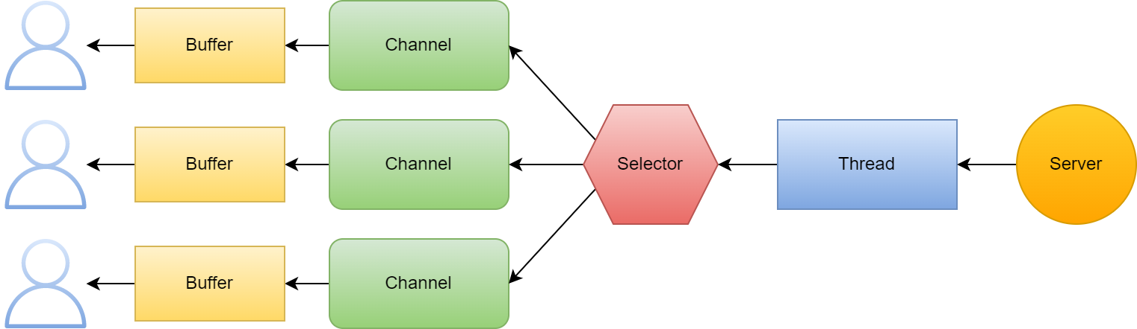
Non-blocking IO – java.nio.*

Slide 23
Non-blocking IO2 – java.nio.*
java.nio.file.Path – interface
Immutable (thread safe)
full support for symbolic links (unlike the File)
java.nio.files.Paths
Does not require file existence for creation of Path object
Path path = Paths.get(“/home/video/movie.mp4");

Slide 24
Names hierarchy
Path songPath = Paths.get("\\home\\video\\..\\audio\\song.flac"); print(songPath); // \home\video\..\audio\song.flac print(songPath.getParent()); // \home\video\..\audio Path normalized = songPath.normalize(); print(normalized); // \home\audio\song.flac print(normalized.getParent()); // \home\audio Path absolute = normalized.toAbsolutePath(); print(absolute); // \home\audio\song.flac print(absolute.getRoot()); // \ print(absolute.getNameCount()); // 3 print(absolute.getFileName()); // song.flac print(absolute.getName(0)); // home print(absolute.subpath(1, 3)); // audio\song.flac

Slide 25
Relativize, resolve
Path path1 = Paths.get("C:\\Windows"); Path path2 = Paths.get("C:\\Program Piles\\JetBrains"); Path path3 = Paths.get("JetBrains"); println(path1.relativize(path2)); // ..\Program Piles\JetBrains println(path2.relativize(path1)); // ..\..\Windows println(path2.relativize(path3)); // Exception! Path path4 = Paths.get("IntelliJ IDEA"); println(path2.resolve(path4)); // C:\Program Piles\JetBrains\IntelliJ IDEA println(path1.resolve(path2)); // C:\Program Piles\JetBrains

Slide 26
Interacting with Files
Path idea = Paths.get("\\Program Files\\JetBrains\\IntelliJ IDEA 2020.1"); Path currentDir = Paths.get("."); // \ Files.exists(idea); // true Files.isDirectory(idea); // true Files.isSameFile(idea, idea.resolve("bin\\..")); // true Files.isSameFile(idea, currentDir); // false Path newIdea = idea.resolveSibling(Paths.get("IntelliJ IDEA 2020.2")); Files.exists(newIdea); // false Files.createDirectories(newIdea); // c:\Program Files\JetBrains\IntelliJ IDEA 2020.2 Files.exists(newIdea); // true

Slide 27
Interacting with Files. Copy, move
Path fun = Paths.get("\\video\\fun.3gp"); Path moreFun = Paths.get("\\video\\moreFun.3gp"); Path moreMoreFun = Paths.get("\\video\\moreMoreFun.3gp"); Files.exists(fun); // true Files.exists(moreFun); // false Files.exists(moreMoreFun); // false Files.copy(fun, moreFun); // shallow copy Files.exists(moreFun); // true Files.exists(moreMoreFun); // false Files.move(fun, moreMoreFun, REPLACE_EXISTING); // shallow movement

Slide 28
Interacting with Files. Delete
Files.delete(fun); // delete
Files.deleteIfExists(fun); // silent delete Files.delete(moreFun); // deleted Files.delete(moreMoreFun); // deleted
Files.exists(fun); // false Files.exists(moreFun); // false Files.exists(moreMoreFun); // false

Slide 29
File Attributes
Path file = Paths.get("\\video\\fun.3gp"); Files.isDirectory(file); // false Files.isHidden(file); // false Files.isReadable(file); // true Files.isExecutable(file); // true Files.isSymbolicLink(file); // false Files.getLastModifiedTime(file); // 2020-12-25T19:43:24.118632Z Files.size(file); // 13

Slide 30
Files search folder content
Files.list(idea).forEach(c::println);
Files.walk(idea, 1).forEach(c::println); // DFS
Files.find(
idea,
1,
(p,a) -> p.startsWith("bin")
).forEach(c::println);

Slide 31
Resources Management

Slide 32
Resources Management
Flushable::flush – trigger data write event if cached
Closeable::close - handles closing a resource (source or destination).
AutoCloseable::close – handles closing a resource (source or destination). Automatically invoked by try-with-resorces

Slide 33
Automatic Resource Management
void copy(File source, File destination) { InputStream in = null; OutputStream out = null;
try { in = new FileInputStream(source); out = new FileOutputStream(destination); int bytesRead; while ((bytesRead = in.read()) != -1) { out.write(bytesRead); } } catch (IOException e) { log.error("Copying failed", e); } finally { close(in); close(out); } }
void close(Closeable resource) { if(nonNull(resource)) { try { resource.close(); } catch (IOException e) { log.error("Close failed", e); } } }

Slide 34
Automatic Resource Management
void copy(File source, File destination) { try (InputStream in = new FileInputStream(source); OutputStream out = new FileOutputStream(destination) ) { int bytesRead; while ((bytesRead = in.read()) != -1) { out.write(bytesRead); } } catch (IOException e) { logger.error("Copying failed", e); } }

Slide 35
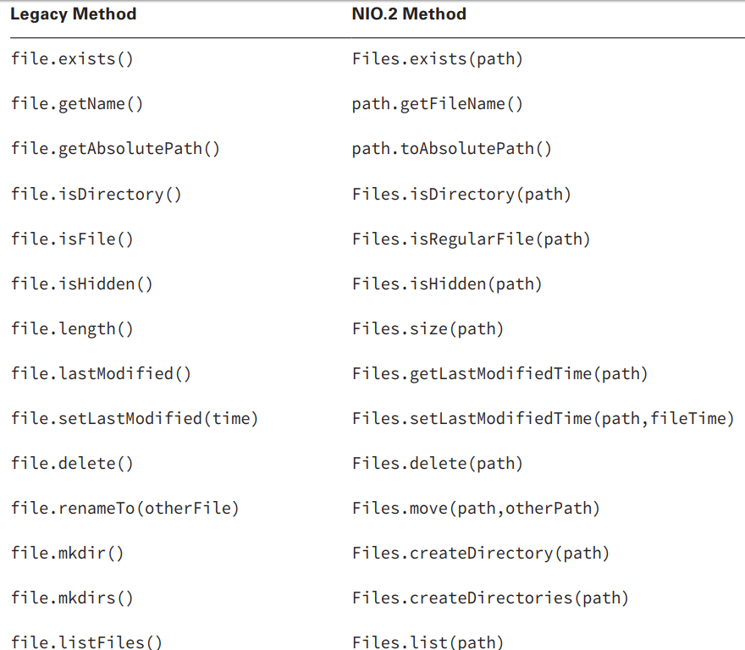
IO vs NIO/2

Slide 36
Data serialization

Slide 37
Data serialization\deserialization
Implement the java.io.Serializable interface
Add serialVersionUID
FileInputStream fis = new FileInputStream(historyFile); BufferedInputStream bis = new BufferedInputStream(fis); ObjectInputStream in = new ObjectInputStream(bis); Object object = in.readObject(); if (object instanceof History) { return (History) object; }

Slide 38
Charsets, Encoding

Slide 39
Encoding
ѓ« ў-л© ‚®Їа®б †Ё§-Ё, ‚бҐ«Ґ--®© Ё ‚бҐЈ®-ўбҐЈ®
Win-1251
UTF-8
ISO-8859-5
…
java.nio.charset.Charset
java.nio.charset.StandardCharsets

Slide 40
Read and Write text files with NIO2
Path src = Paths.get("/source.txt"); Path dest = Paths.get("/destination.txt"); BufferedReader reader = Files.newBufferedReader(src, US_ASCII); BufferedWriter writer = Files.newBufferedWriter(dest, UTF_8) String currentLine; while ((currentLine = reader.readLine()) != null) { writer.write(currentLine); } reader.close(); writer.close();

Slide 41
Homework. Logs.
Implement possibility to save logs in file.
At the beginning of the program, read this file and load all logs from it.
Add functionality to sort logs by date
Add functionality to select a group of logs by its status

Slide 42
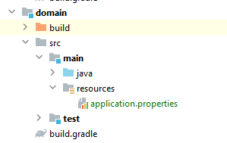
Homework. Logs.
Implement possibility to choose the place where logs will be stored(in-memory or in-file). Use Strategy pattern for that.
At the beginning of the program load property ‘logger.storage.type’ from application.properties file. If storage type == file - then store logs in file, otherwise use in-memory storage.

Slide 43
Links
IO/NIO - Oracle
IO/NIO - Developers Zone
IO/NIO - Tutorialspoint

Slide 44
Thanks!
Any Questions?
Or find us in Slack:
@Nikolenko Vladyslav

